Slide 1

Internet Sales 2013

Slide 2
Project Name
Adventure Works Internet Sales.

Slide 3
Main Objectives
Converting from static reports to visual reports.
Showing how much sold from which products and to which customers.
Trend analysis for sales performance over time.
Comparing the sales against the budget.

Slide 4
Project metadata
Title | Description
Stakeholder Name | Yasser Alaa - Sales Manager
Data analyst | Mahmoud Elrasool
Dataset Used | AdventureWorksDW2022
Database Used | Microsoft SQL Server
Data Modelling | Snowflake Schema
Visualization tool | Microsoft Power BI
Dataset # of rows | 54771
Segmentation method | Demographic Segmentation

Slide 5
Project Brief
Writing queries in SQL server:
Cleaning data and get rid of not needed columns.
Calculating age using DATEDIFF function.
Age segmentation by using “CASE WHEN” clauses.
Modifying gender values using “CASE WHEN” clauses.
Connecting Power BI with SQL server management studio.
Using Snowflake schema, linking the tables to each other in Modelling view in Power BI.

Slide 6
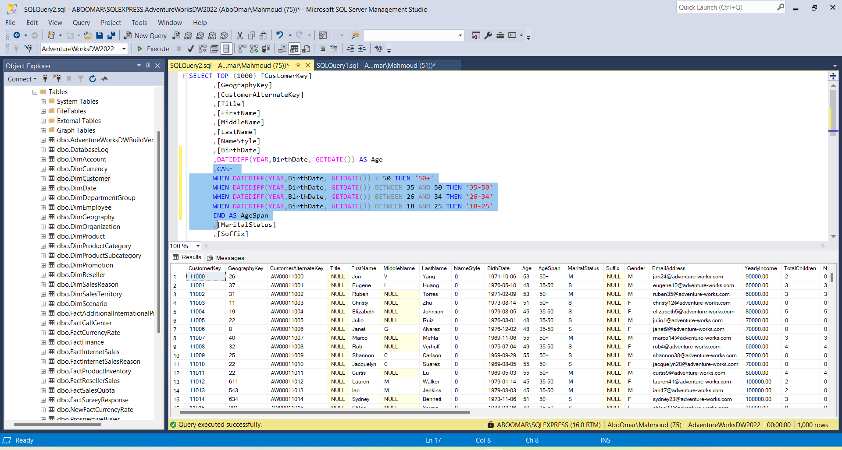
Modelling DimCustomer

Slide 7
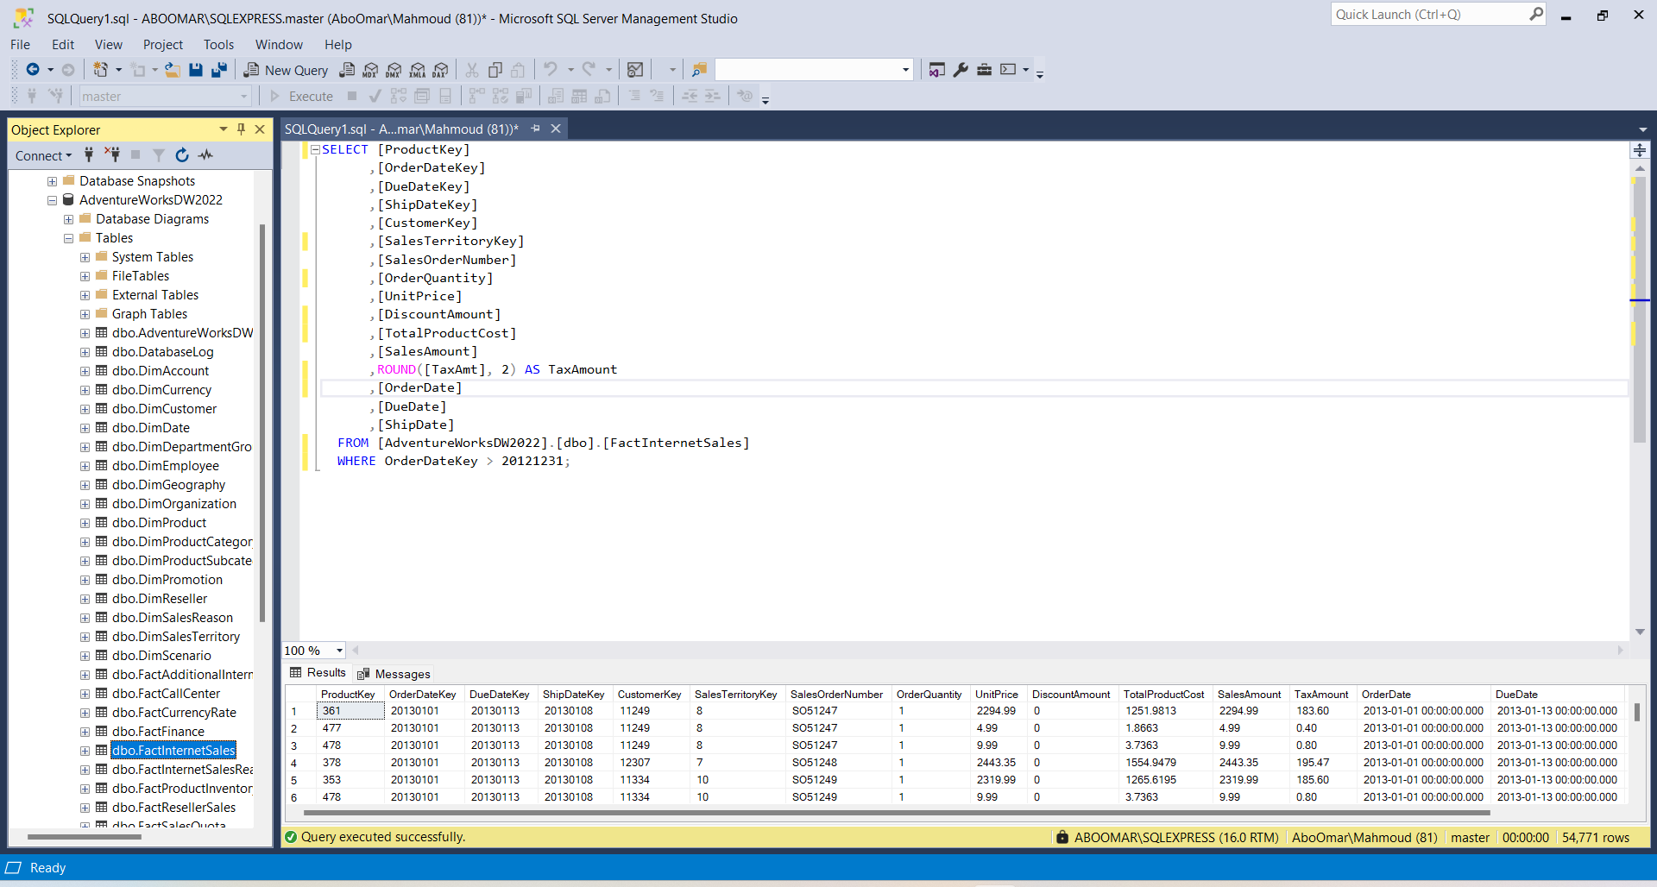
Modelling FactInternetSales

Slide 8
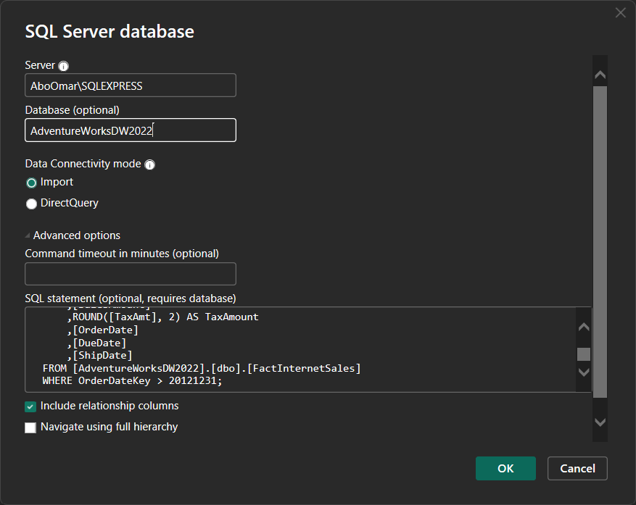

Slide 9
Analysis Result For 2013
The total amount of sales is $16.35M.
The # of products sold is 52.8K.
The best-selling product is “Mountain-200 Black,42”.
We have $1.03M as a profit against budget.
The highest buying customer is Jordan Turner.
The trend analysis shows that 4 months the revenues were below the budget, February, July, September and December.

Slide 10
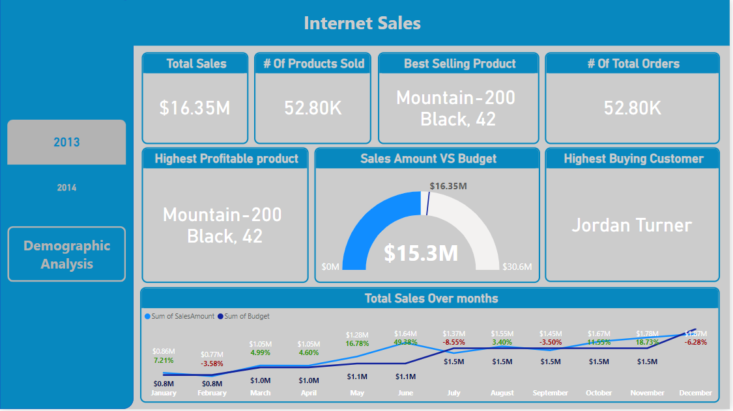

Slide 11
Demographic Analysis
The demographic analysis is based on Gender, Age, Occupation level, # of children, Yearly income and Marital status.
It reveals the following:
Customers older than 50 were higher than the others with total amount of $9.5M.
Customers who have no children were the highest among the others with total amount of $9.6M.
Customers with the title “Professional” were the highest among the others with total amount of $5.8M followed by “Skilled Manuals”.
Married customers were higher than single customers with total amount of $8.7M.
There was a nuance difference between male and female customers.
Regarding the yearly income, the high-income customers were the highest, followed by low-income customers.

Slide 12
